Slide 1
Group Project 1 Dawlat Hamad | Nathan Chantiny | Riley Deason

Slide 2
Task Distribution
Dawlat Hamad:
Front End, GUI & Coding, Documentation
Nathan Chantiny:
Scrum Master, GUI & Coding, Application Compilation
Riley Deason:
GUI & Coding, Presentation

Slide 3
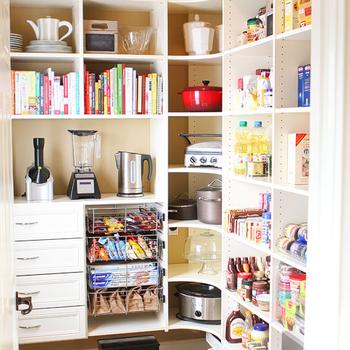
Project Overview

Slide 4
Community Fridge
We have built an application designed to make inventory of shared fridges simple and efficient. Using our graphical interface, users can add, remove, and update products in the fridge as well as view information such as expiration date, date added, and dietary details.

Slide 5
Software Used
VS Code – Editor used for website and application development
PyCharm – Editor used specifically for Python development
Python – Programming language used for the application
HTML – Programming language used for website development
Github – Used for application development and distribution as well as website hosting
Tkinter – Used to develop graphical user interface
JSON – Used for databasing elements stored by the application

Slide 6
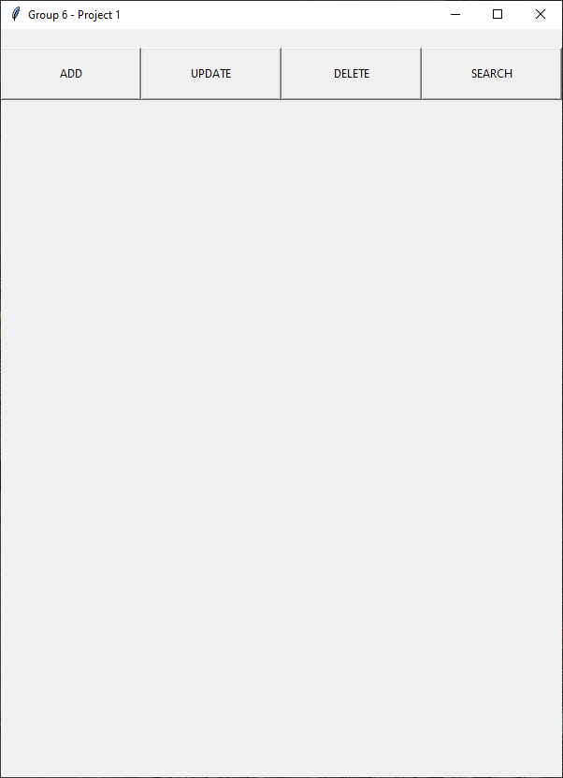
Application Homepage
Shows headers for user to add to, update, delete from or search fridge inventory

Slide 7
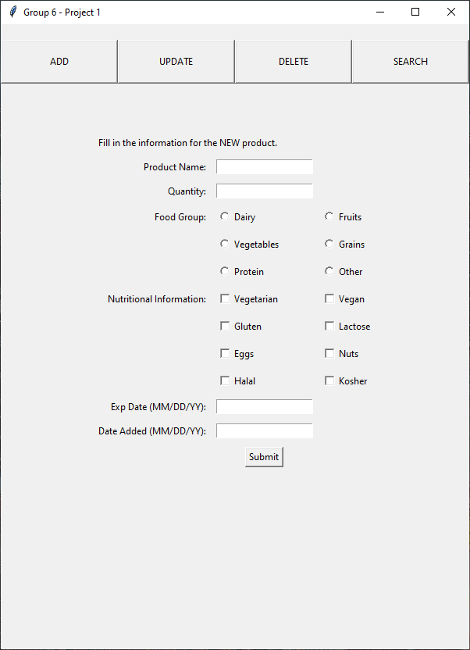
Add
Displays form for user to add element to fridge inventory, prompting for information such as product name, quantity, food group, nutritional information, expiration date, and date added

Slide 8
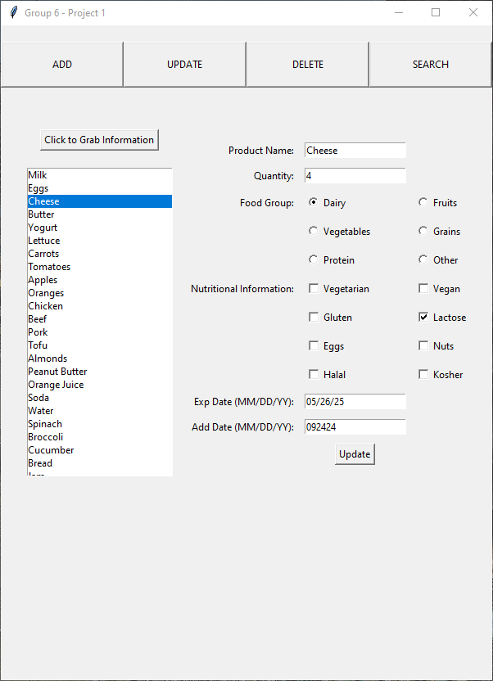
Update
Displays full fridge inventory, allowing user to select an element and make changes to its attributes

Slide 9
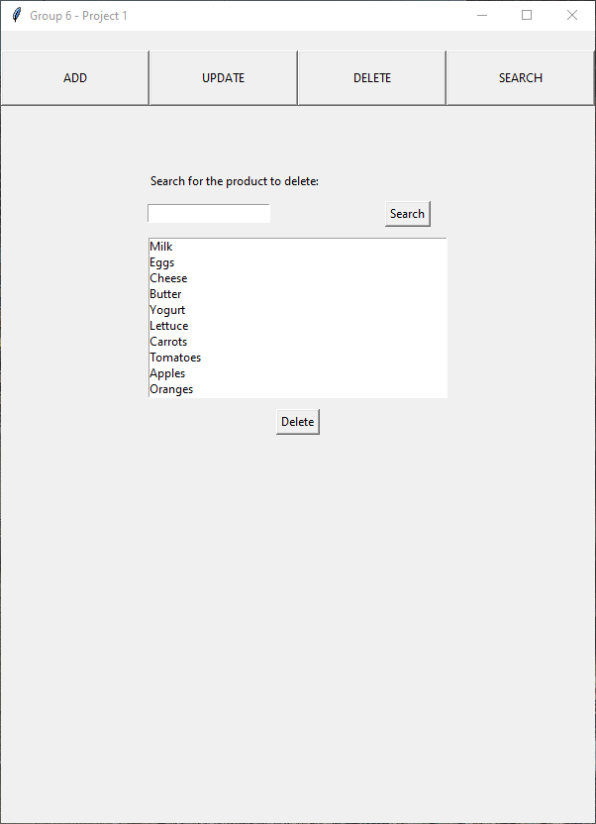
Delete
Allows the user to select an element to delete from fridge inventory, as well as a search box to make finding items simpler

Slide 10
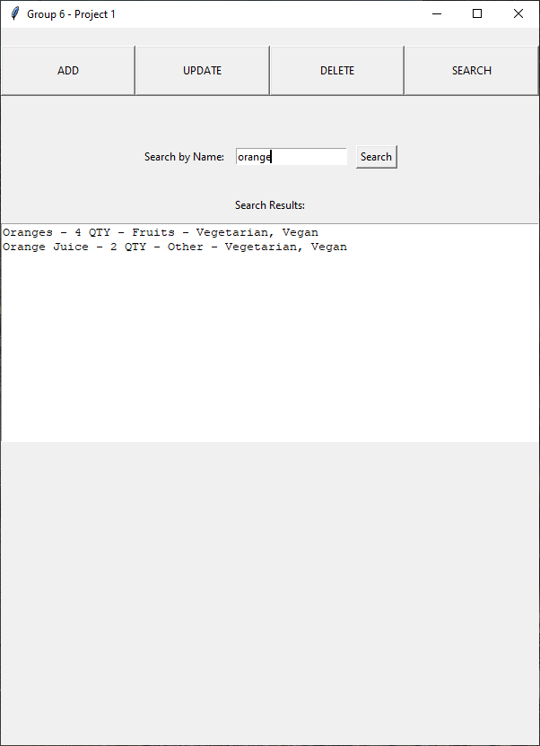
Search
Allows user to search fridge inventory using keywords. Search results show element information and quantity

Slide 11
Why us?
Backing our team means backing a team of winners. We offer a wide breadth of knowledge and experience with focus on functionality, usability, and style. We are committed to delivering the finest product available and will stop at nothing to achieve that.

Slide 12

Thank you!

